Slide 1

Hospital Management System
Using Cisco Packet Tracer

Slide 2

Design By:
Mrunali Virkud
Samidha Vele
Vipul Karle
Anket Uppal

Slide 3

Introduction
With an ever-growing need for healthcare and healthcare facilities, large hospitals and their subsidized branch facilities are demanding more stable and reliable sources for network solutions. The field of Information Technology and Network Infrastructure Management has become crucial components within the healthcare industry. Today, many hospitals, clinics, and outpatient care providers are taking full advantage of the benefits that modern technological advances have to offer.

Slide 4

Objectives
Main objectives of a Hospital Management System are:
Design a system for better patient care.
Reduce hospital operating costs.
Provide MIS (Management Information System) report on demand to management for better decision making.
Better co-ordination among the different departments.
Provide top management a single point of control.

Slide 5

Features
Appointment Management
Billing Management
Prescription Management
Discharge Summary
Operation Theatre Management
Pharmacy Management
Lab Management
Any number of branches can be added and managed using a single account.

Slide 6

Advantages
Time-saving Technology
Improved Efficiency by avoiding human errors
Reduces scope for Error
Data security and correct data retrieval made possible
Cost effective and easily manageable
Easy access to patient data with correct patient history
Improved patient care made possible
Easy monitoring of supplies in inventory
Reduces the work of documentation
Better Audit controls and policy compliance.

Slide 7

Network Design
The Network Architecture
Network Connectivity
Ping Test

Slide 8
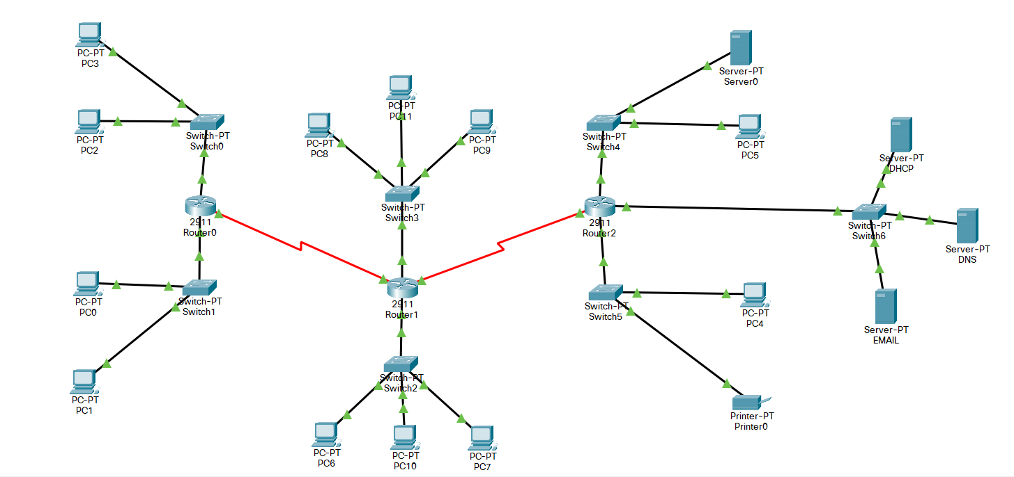
Network Architecture

Slide 9
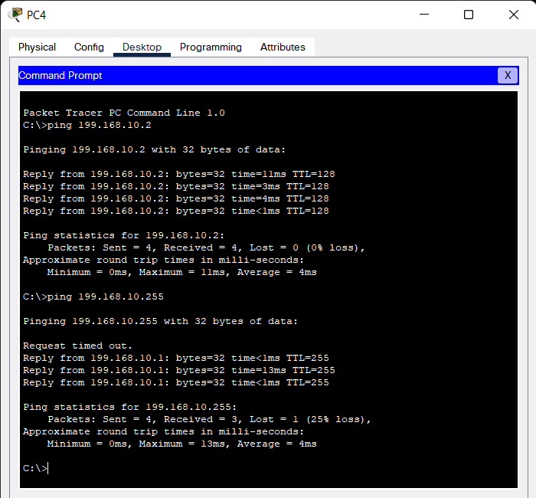
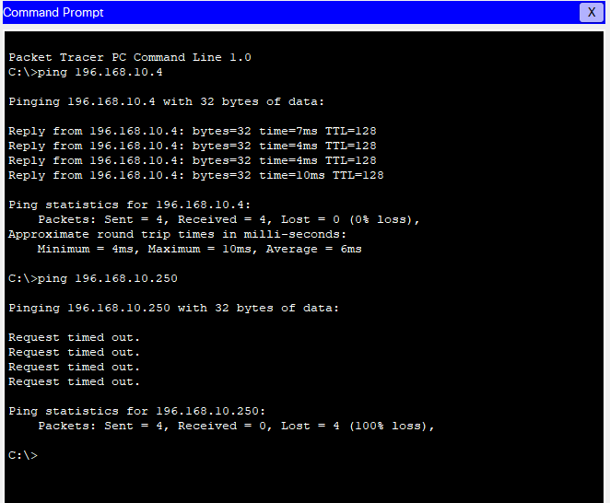
Ping Test

Slide 10

Thank You

